Slide 1

Koala Inventory Management System

Slide 2
Introduction
This inventory management system simplifies tracking inventory, orders, and deliveries with real-time stock updates and automated alerts, supporting multi-location and system integration.

Slide 3
Objectives
Stockouts and Overstocks
Inefficiency
Poor Visibility
Time-Consuming Reporting

Slide 4
Target Audience
The primary users of this system are warehouse operators who need to efficiently manage inventory across various locations.

Slide 5
Brief
An Inventory Management System (IMS) streamlines tracking of stock, orders, and deliveries with real-time updates and automated alerts. It supports multi-location management and integrates with systems like accounting and supply chain. Built-in authentication and authorization ensure secure access, allowing only authorized users to manage inventory and operations.

Slide 6
Technology stack
ASP.NET MVC
SQL SERVER
AJAX for asynchronous communication
jQuery for enhancing the user interface.

Slide 7
Database Design

Slide 8
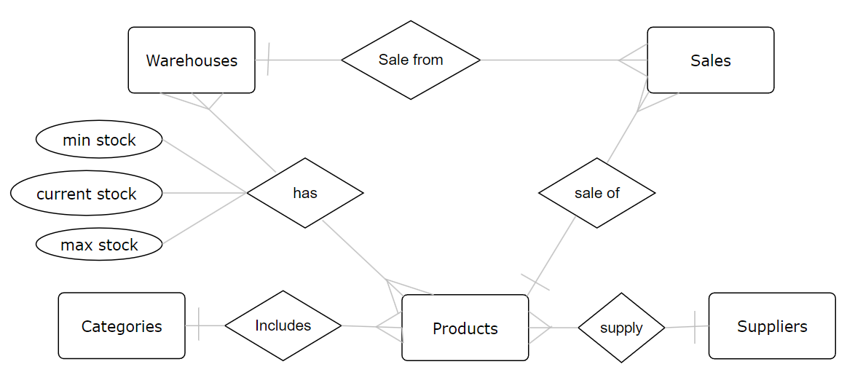
ER diagram simplified

Slide 9
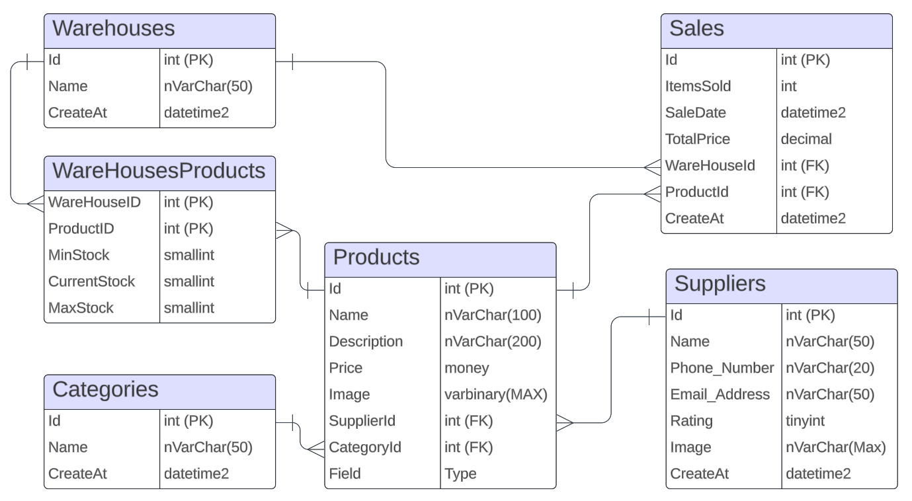
mapping

Slide 10
System Architecture

Slide 11
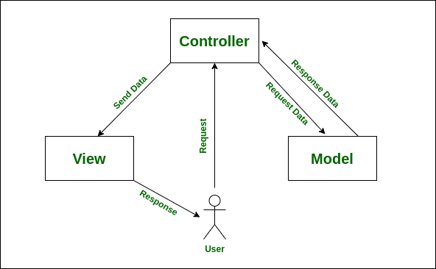
MVC Architecture
Disadvantages of Using a Normal MVC Project Structure:
• Tightly Coupled Code
• Limited Scalability
• Difficulty in Unit Testing
• Poor Reusability
• Inflexibility in Data Access Layer
• Violated SOLID Principles

Slide 12
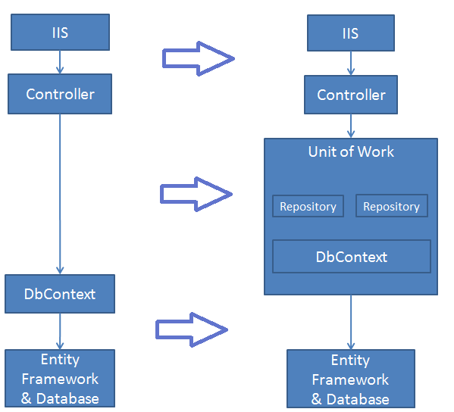
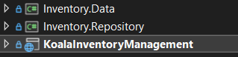
Solution: repository pattern
Advantages:
• abstracts the data access
• separates data access from business logic
• supports dependency injection
• flexibility in changing data source
• 3 layers

Slide 13
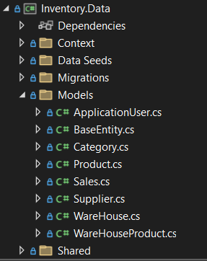
Data Layer
Includes:
• Database Context
• Migrations
• Models
• Data Seeds

Slide 14
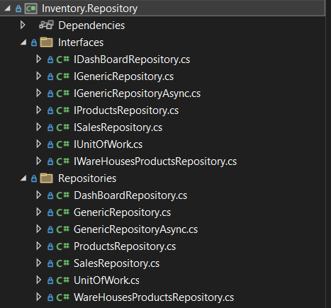
Repository Layer
Includes:
• Interfaces
• Repositories

Slide 15
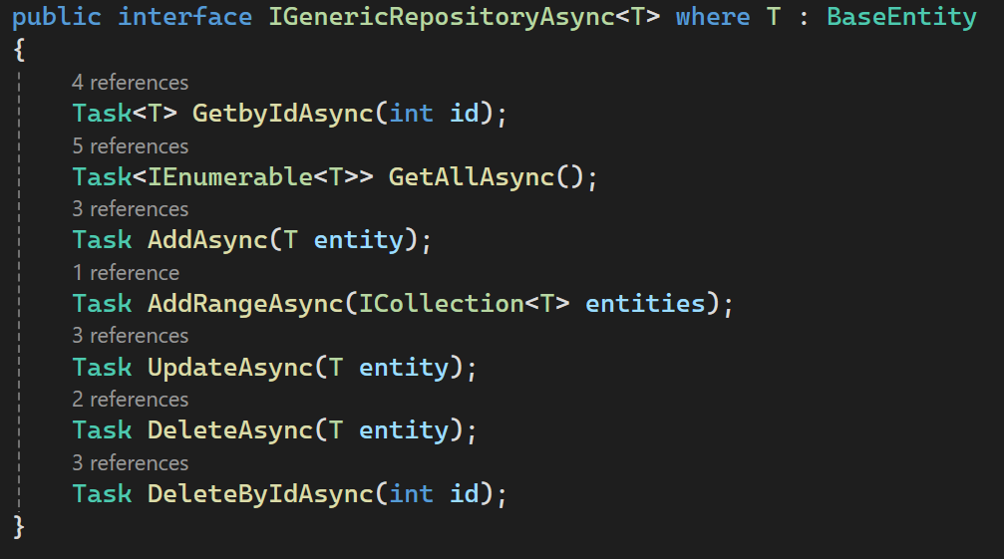
Generic repository
Includes:
• Centralized Logic
• Basic CRUD operations

Slide 16
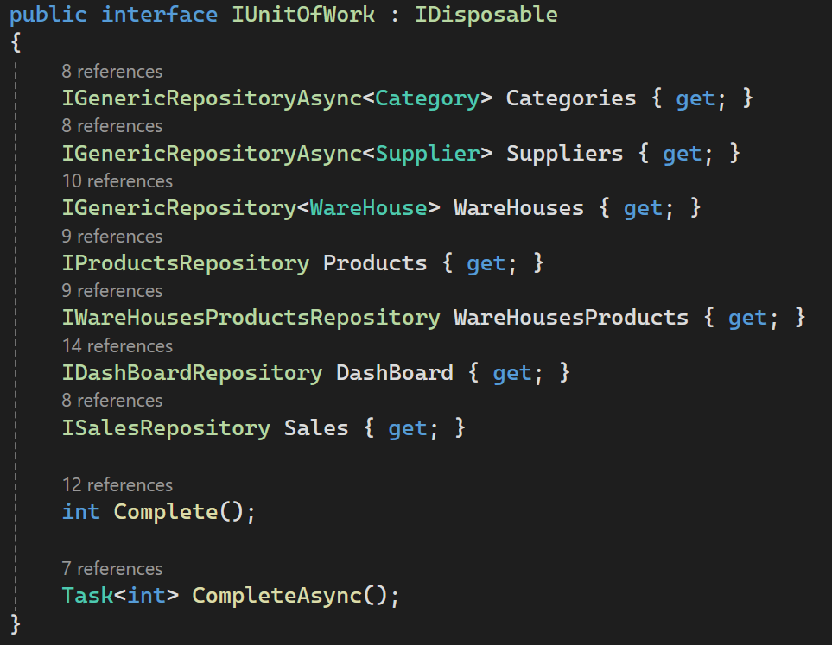
UNIt of work
Includes:
• All Repositories
• All operations as a single transaction
• Single _Context
• Complete method which saves
changes

Slide 17
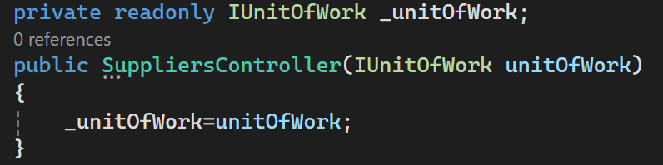
Using UNIt of work
Steps:
1- Register the unit of work as a service
2- Use Dependency injection to inject
the unit of work
3- Use the methods inside

Slide 18
Dashboard

Slide 19
Dashboard BoldPoints
Full Statistics of warehouses, Products and stock
Each warehouse statistics
Low stock taple
Average sock category chart

Slide 20
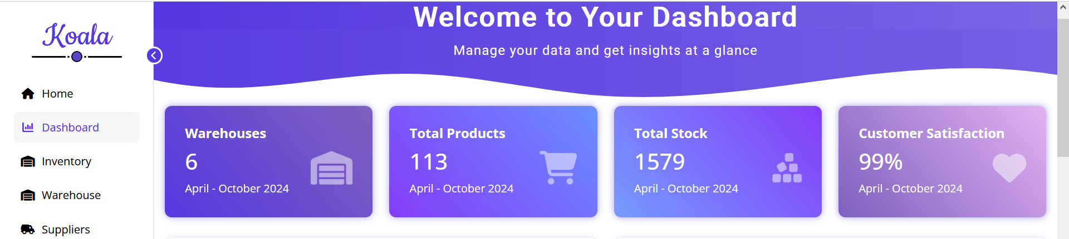
Inventory Statistics
Warehouse: Numbers of all warehouses in system
Total Products: Total numbers of products in warehouses
Total stock : Total stocks in all warehouse of all products

Slide 21
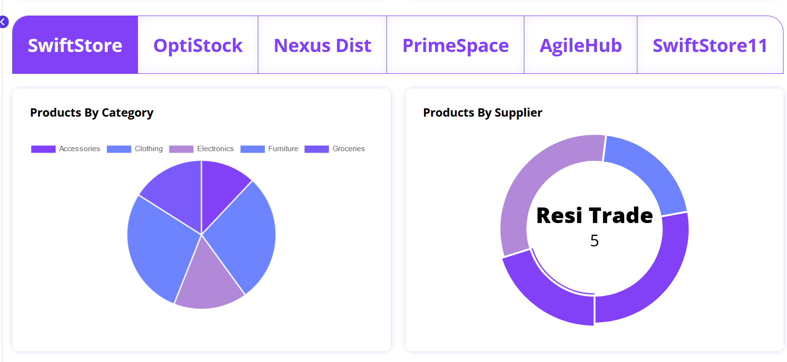
Each warehouse Statistics
Warehouses Taps
Products in each category in selected warehouse
Supplier of each category in selected warehouse

Slide 22
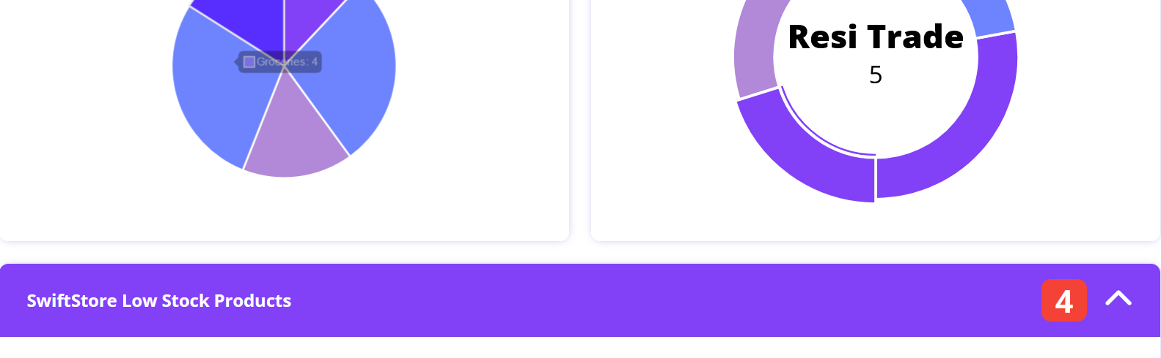
Low stock products
Table contain each product in selected warehouse which current stock is less than minimum stock required

Slide 23
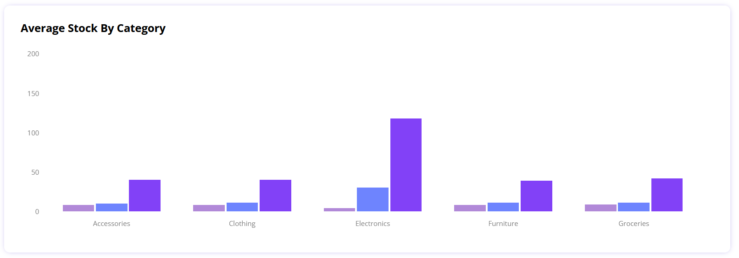
Average Stock by category
Average of products in each category

Slide 24
INVENTORY

Slide 25
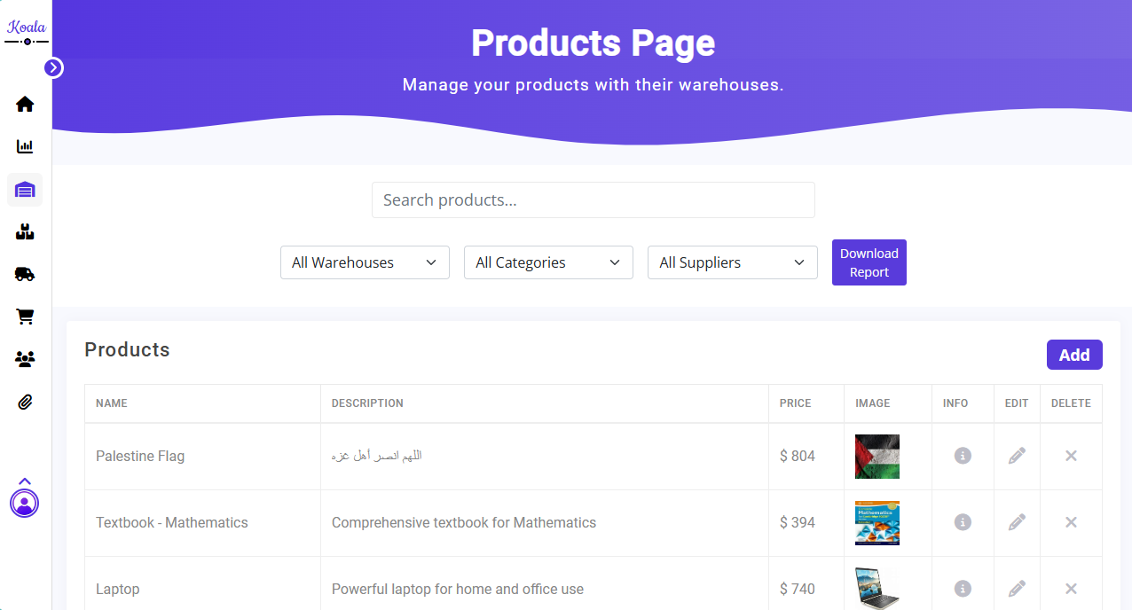
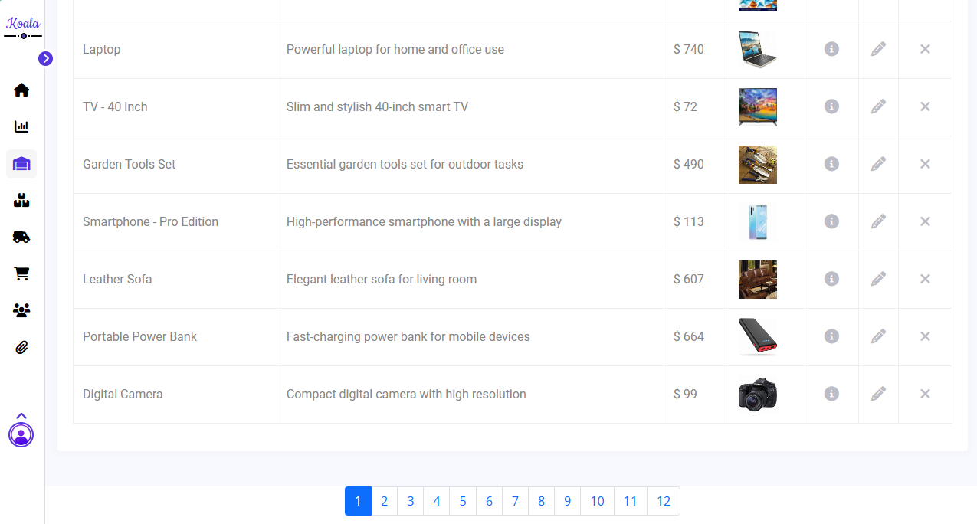
Inventory Features
Product Name
Print
Filtration
Warehouses
Categories
Suppliers
Includes:
• Filtration
• CRUD Operations
• Pagination
• Reports
Paginate

Slide 26
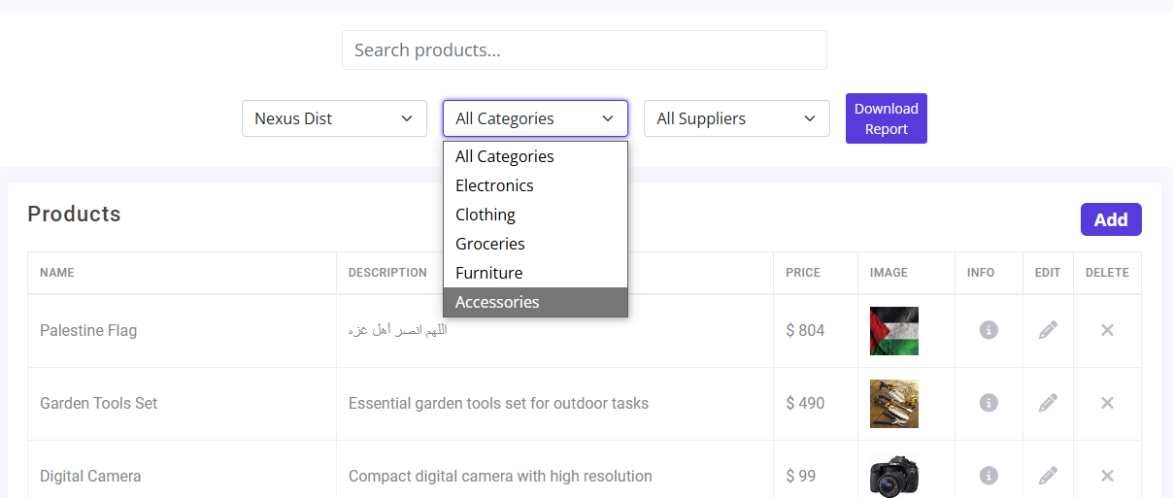
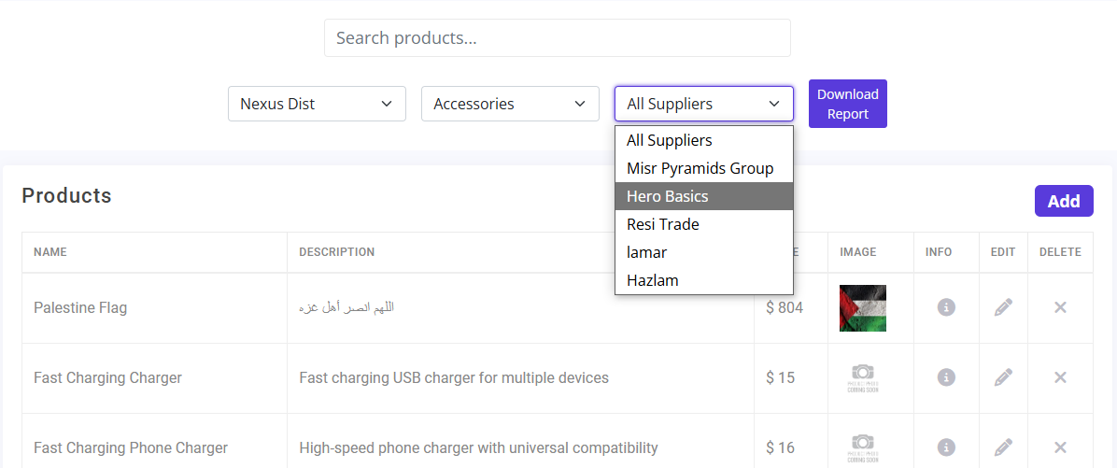
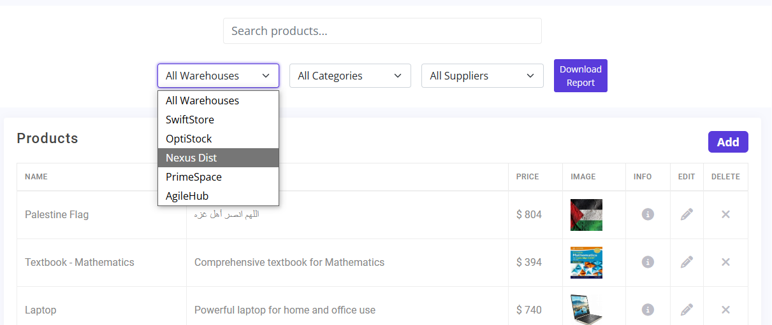
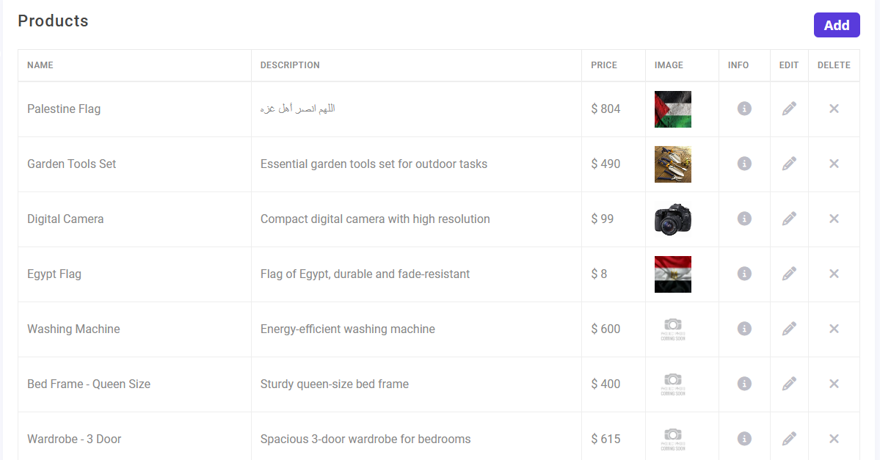
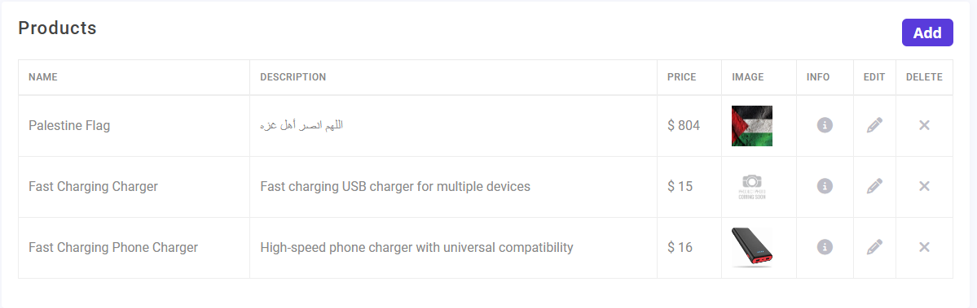
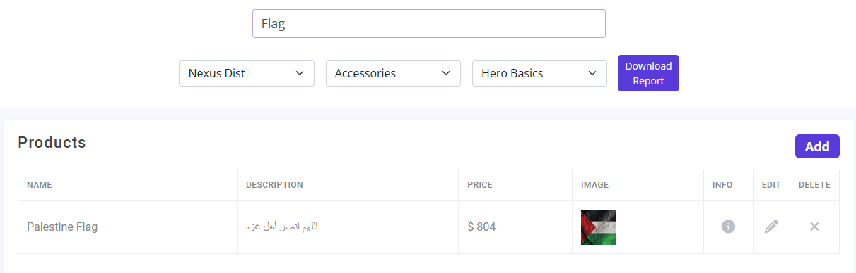
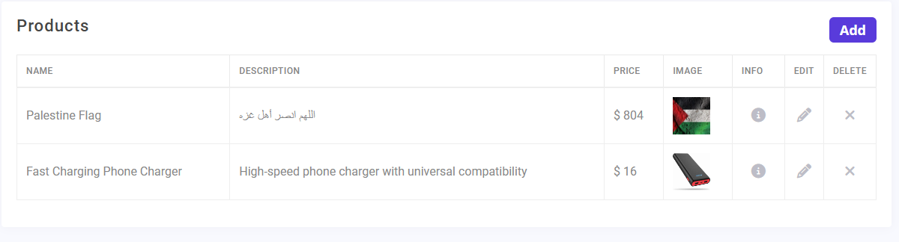
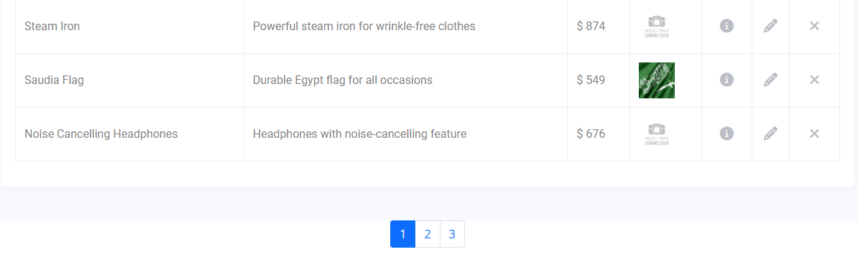
Filtration
Filter by Warehouses
3. Filter by Supplier
2. Filter by Category
4. Filter by Product Name

Slide 27
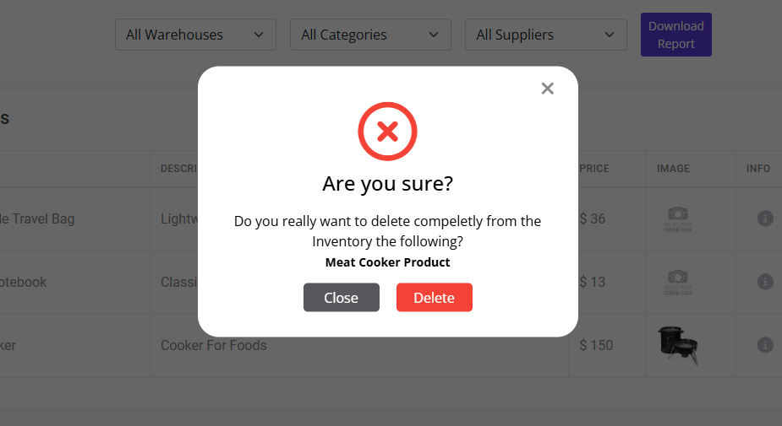
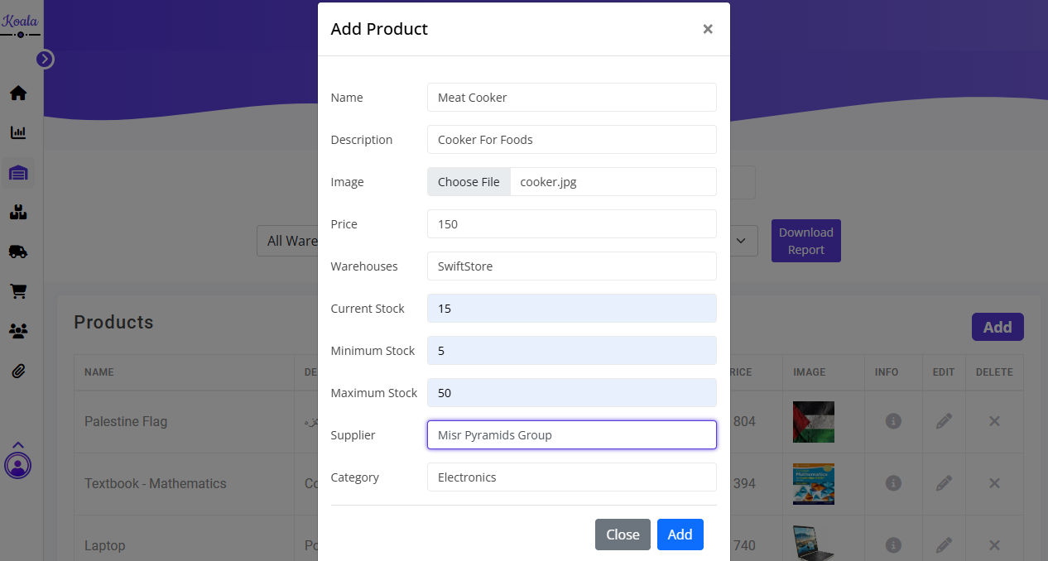
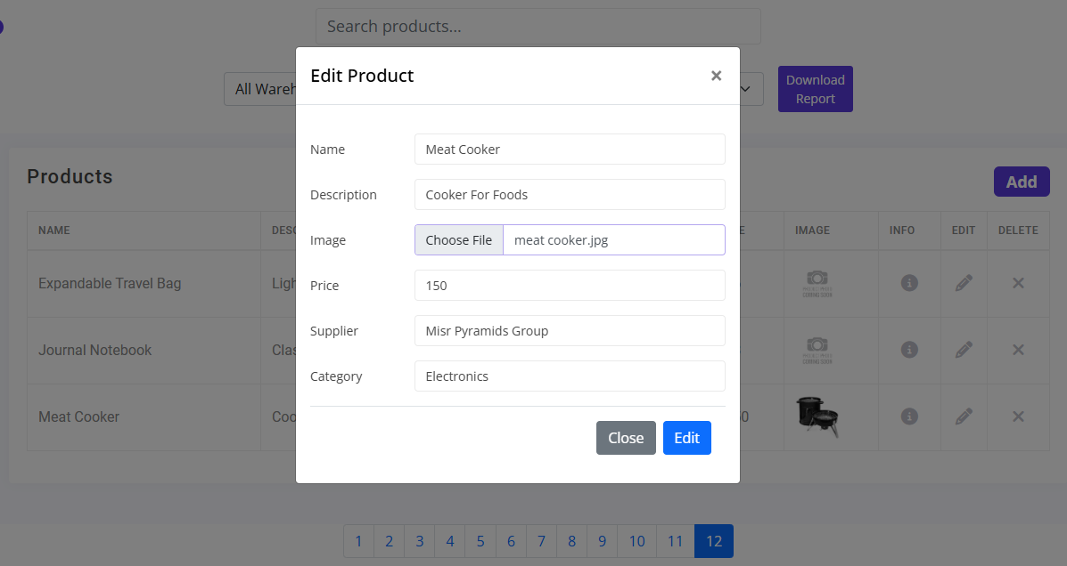
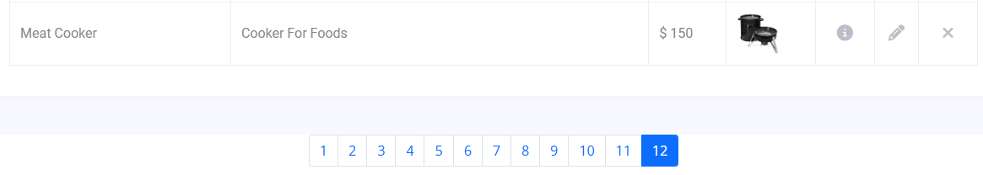
CRUD Operations
1. Add
3. Delete
2. Edit

Slide 28
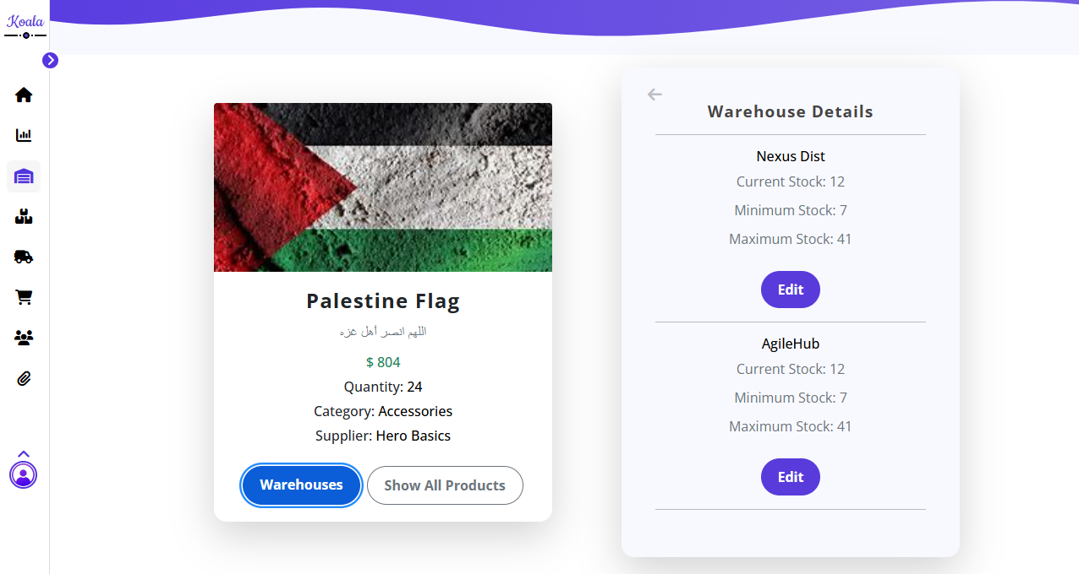
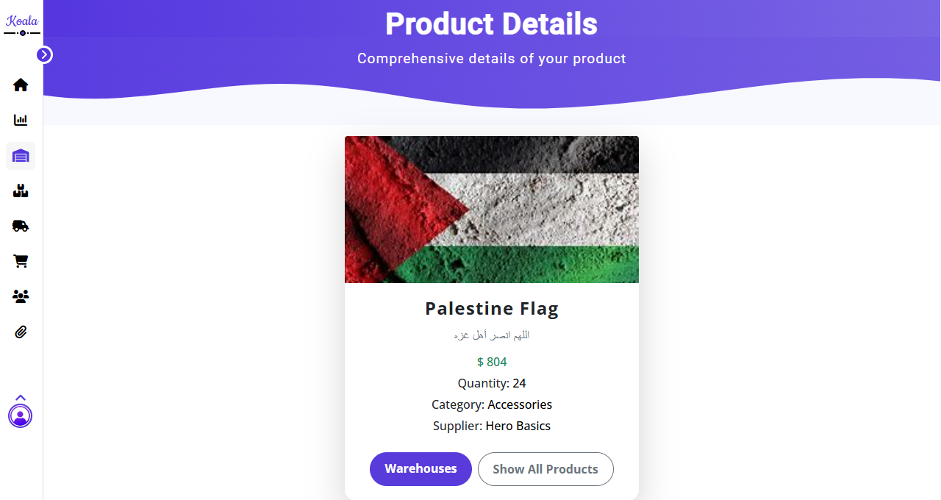
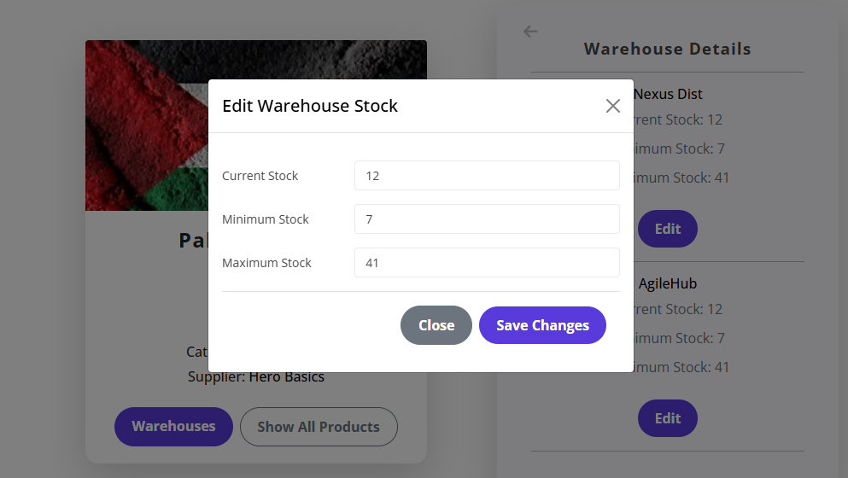
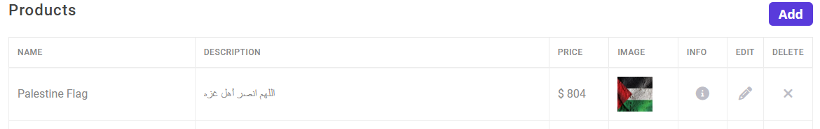
Details Page

Slide 29
Supplier

Slide 30
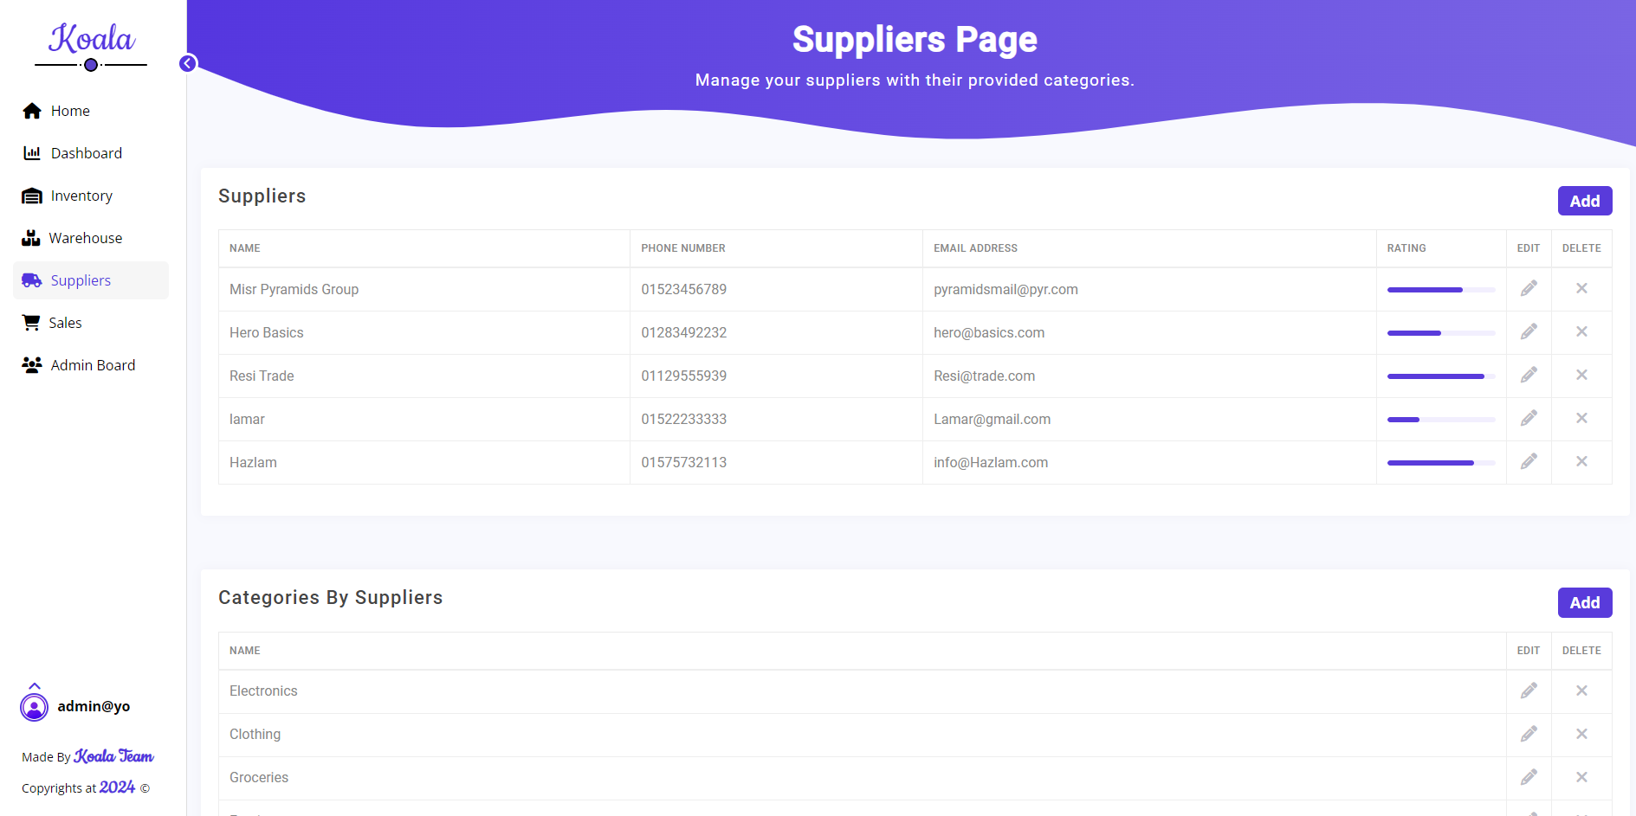
Suppliers page
Contains two entities:
Suppliers
Categories

Slide 31
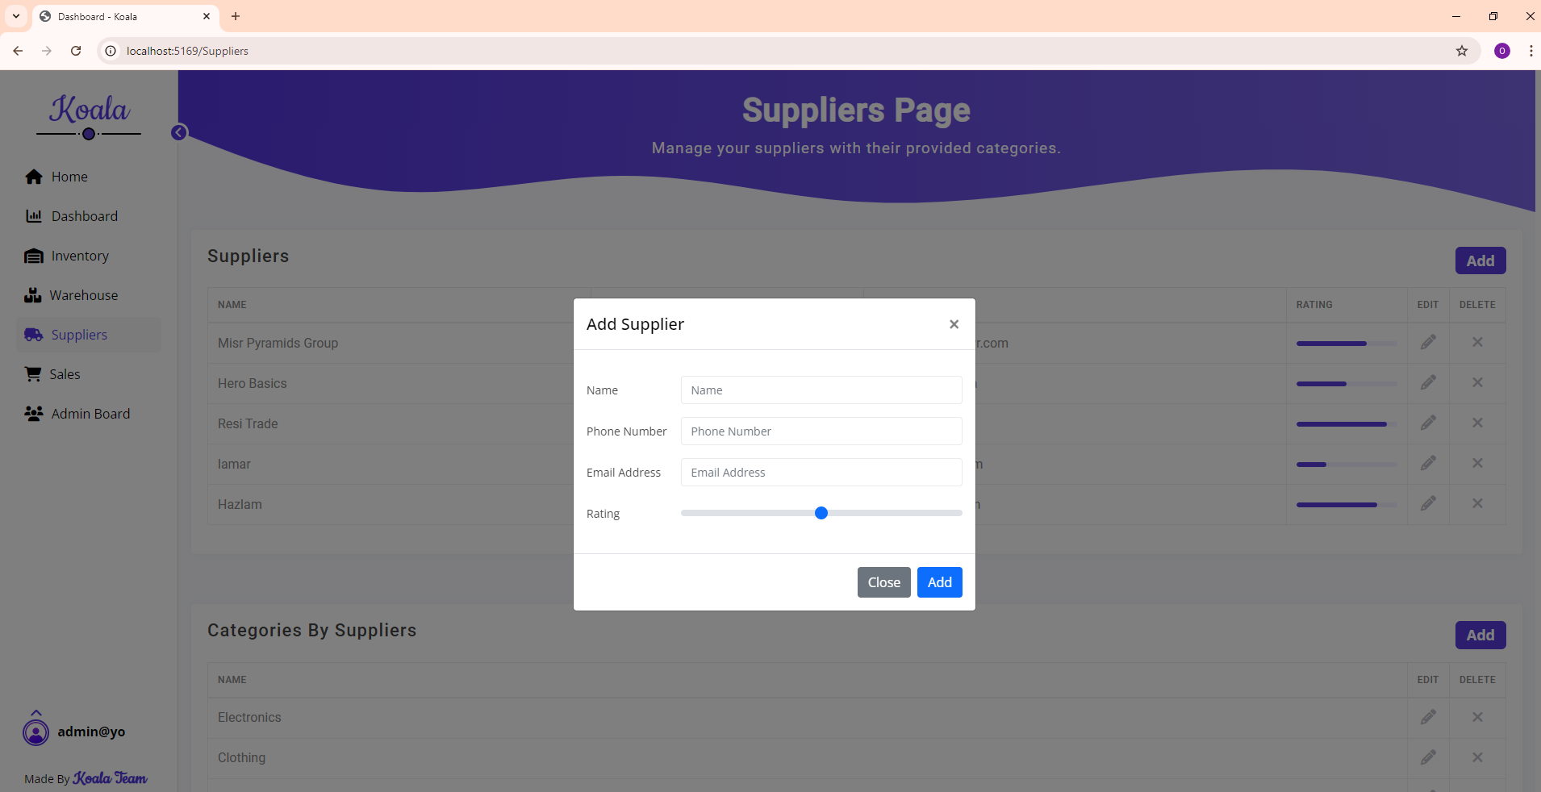
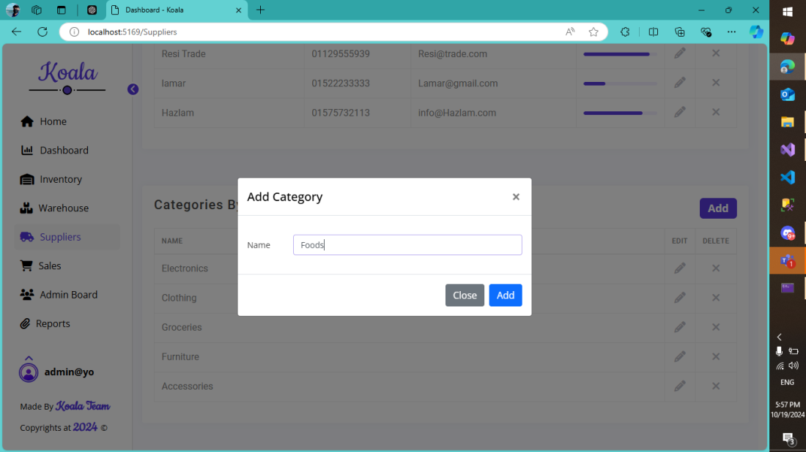
addition

Slide 32
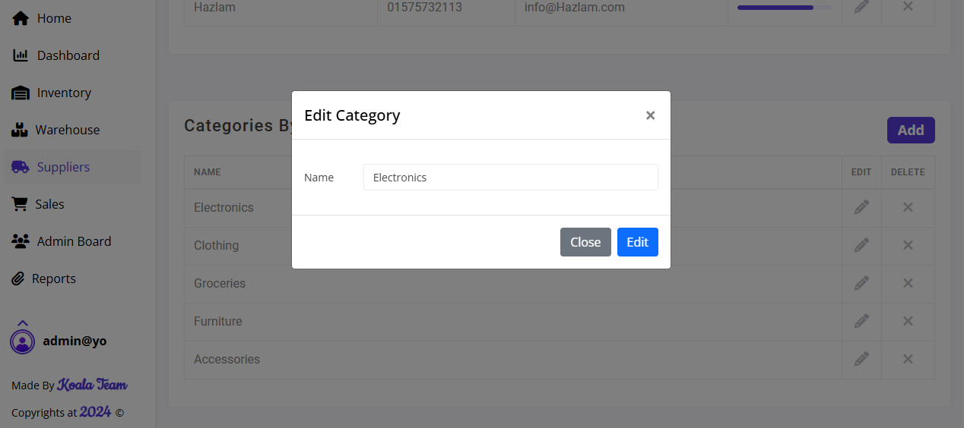
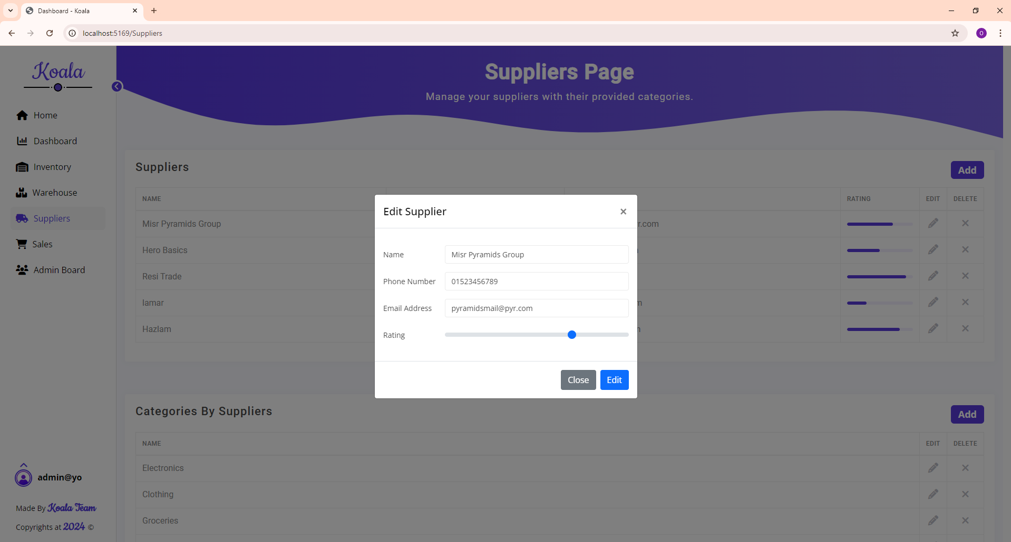
Supplier editing

Slide 33
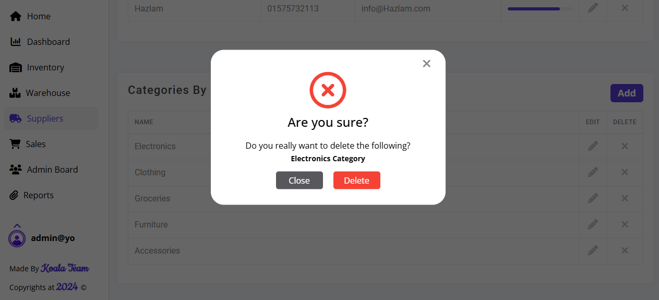
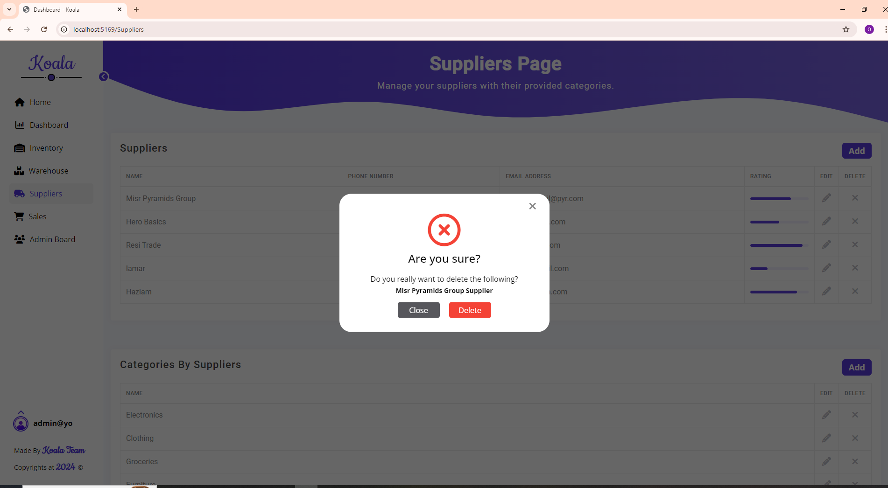
Suppler deletion

Slide 34
sales

Slide 35
Main points
Fetching Data
Pagination
Add functionality
Delete functionality

Slide 36
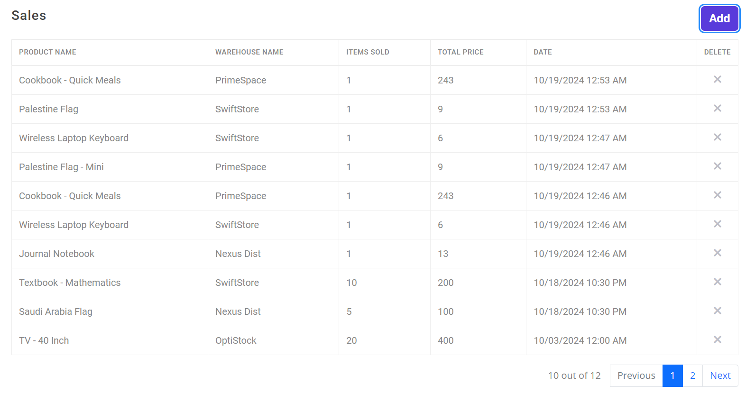
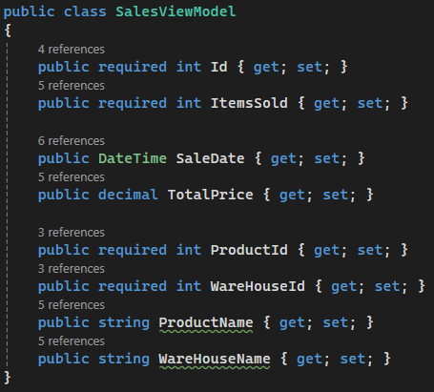
fetching data
Data returned in DESC order.
Product and warehouses.
SalesViewModel.

Slide 37
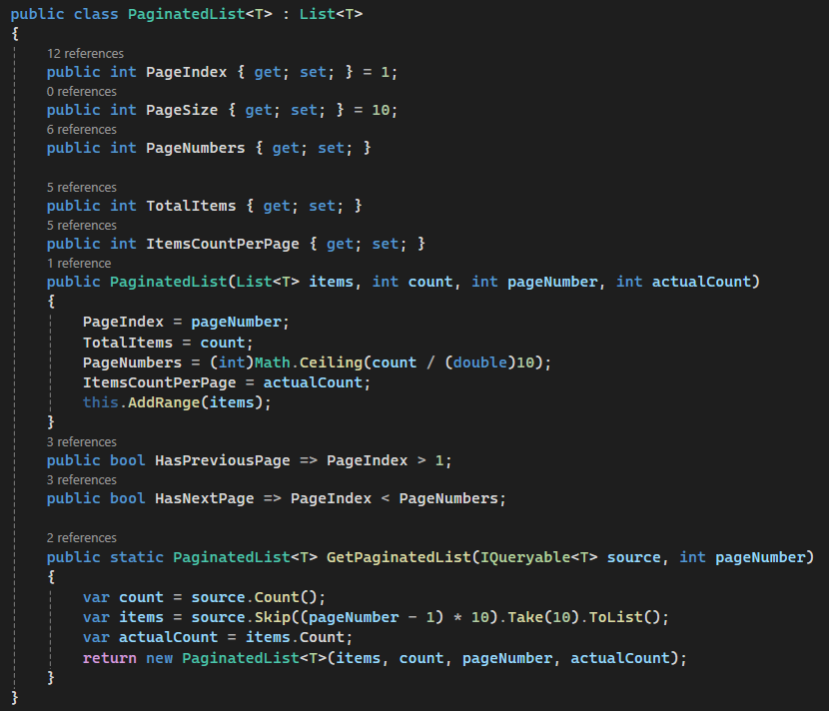
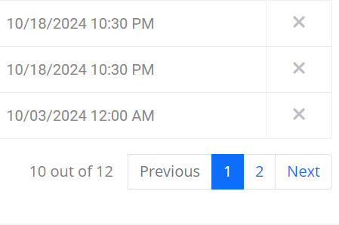
Pagination
Extending functionality (Inheritance)
Data returned in chunks.
Tracking various information.
Keeping order of fetched data.

Slide 38
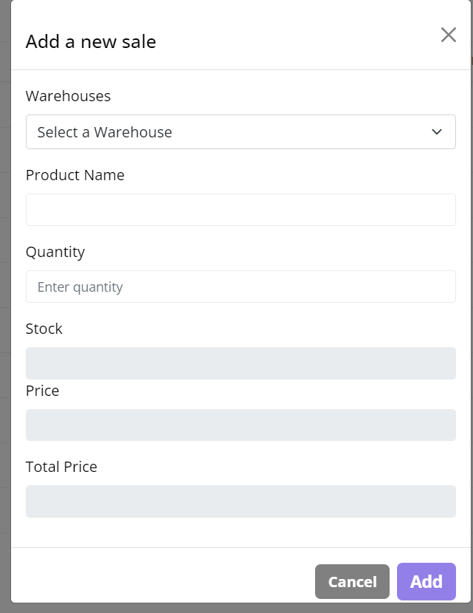
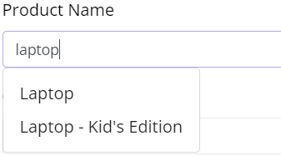
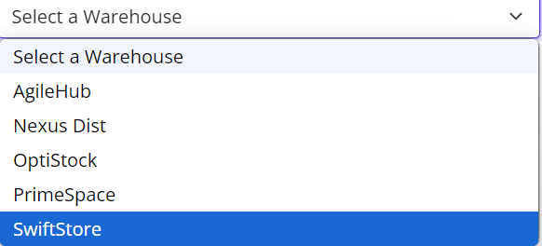
Add functionality
Choose a warehouse.
Choose a product inside selected warehouse.
Display (Stock – Price – Total Price).
Validation on quantity input field.
AJAX Request to:
Update Table.
Update Navigation buttons.

Slide 39
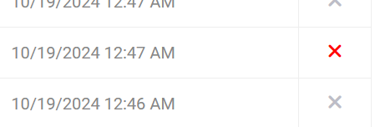
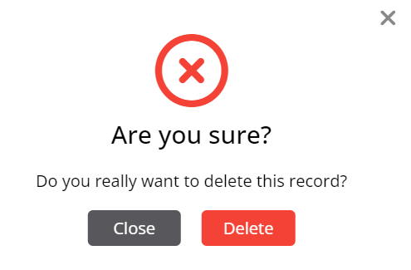
DELETE functionality
Retrieve clicked row’s id.
Delete dialog box.
AJAX Request to:
Update Table.
Update Navigation buttons.

Slide 40
Challenges and Solutions
Implementing real-time stock tracking for each warehouse AJAX Requests.
Maintain Data Integrity Frontend and Backend Validations.
Cooperating in a team Git/Github – Data Seeding.

Slide 41
Future Enhancements
Barcode Scanning Integration.
Customer Orders Integration.
Online Payments and 3rd- party proprietary software for Credit Card Validation.
API for External Integration.

Slide 42
CONCLUSION
Universal System.
Interactive dashboard (warehouse products – stock level alerts).
Authentication and Authorization (Access Restriction).
Sales Page (warehouse products – quantities – total price – sale date).

Slide 43

Thank you

Slide 44

Questions?

